Slide 1

Vel Tech Rangarajan Dr. Sagunthala R&D Institute of Science and Technology
School of Computing
Department of Computer Science and Engineering
10211CS224 / FULL STACK APPLICATION DEVELOPMENT (JAVA)
END SEMESTER PROJECT REVIEW
Date: 06-05-2026
JOB PORTAL MANAGEMENT SYSTEM
SDG: 9 – Industry, Innovation and Infrastructure
Presented By:
CHERIPALLY SURYA SRINIDHI – VTU24957 – 23UECS0691
Courses Handling Faculty:
Dr. S. Hemamalini – Assistant Professor(Senior Grade)-M.E,Ph.D

Slide 2
INTRODUCTION
Traditional job hunting is often fragmented, lacking real-time tracking and intuitive guidance for candidates.
This creates a stressful disconnect between talented graduates and employers struggling to manage applicants.
Our Job Portal solves this by providing a centralized, intelligent platform bridging students and recruiters.
This project is important because it streamlines hiring, significantly reducing friction for both parties.
In the real world, immediate feedback is vital; our automated email notifications ensure candidates are never left in the dark.
The integration of a smart AI Chatbot provides instant, 24/7 assistance to help users navigate and apply seamlessly.
Employers benefit from a powerful dashboard to effortlessly post jobs, review resumes, and update applicant statuses.
Overall, the system is a modern, scalable web application built with Spring Boot to revolutionize career networking.
1
2
3
4
5
6
7
8
9

Slide 3
PROBLEM STATEMENT
The current recruitment process is often highly manual, fragmented, and inefficient for both applicants and employers.
Job seekers struggle to find relevant roles, track application statuses, and get immediate answers to their queries.
Employers face difficulties managing large volumes of applicants and communicating updates in a timely manner.
Existing systems lack intelligent automation, real-time feedback, and interactive tools like spatial mapping or AI assistance.
This leads to prolonged hiring cycles, missed opportunities, and poor user experiences for both parties.
Therefore, there is a critical need for a centralized, fully automated Job Portal System.
This system must streamline job posting, application tracking, and communication through automated email workflows.
By integrating AI assistance and interactive mapping, the platform will significantly improve performance, accuracy, and overall engagement.
1
2
3
4
5
6
7
8
9

Slide 4
OBJECTIVE(S)
Develop a Centralized Platform: To build an automated, fully-responsive Job Portal with dedicated dashboards that seamlessly connect students with prospective employers.
Integrate Intelligent Features: To enhance user experience by implementing an AI-powered Chatbot for instant assistance and interactive mapping for localized job discovery.
Streamline Communication: To optimize the hiring workflow by creating a robust, real-time email notification system that tracks application statuses and delivers instant updates.
1
2
3
4
5
6
7
8
9

Slide 5
PROPOSED SYSTEM
Comprehensive Solution: A centralized, automated web portal built with Spring Boot that connects students and employers in a unified ecosystem.
Dedicated Dashboards: Provides tailored, intuitive interfaces for both students (to apply) and employers (to manage applicants), completely eliminating manual tracking.
Automated Communication: Replaces disjointed, manual follow-ups with an integrated SMTP notification system that sends instant application confirmations and status updates.
Intelligent Assistance: Integrates a Google Gemini-powered AI Chatbot to provide users with 24/7, context-aware support and navigation guidance.
Geospatial Discovery: Incorporates an interactive spatial mapping system, allowing students to visualize job locations and make geographically informed career decisions.
Data Integrity & Security: Solves data loss and fragmentation issues by utilizing a robust, persistent MySQL backend for secure data storage.
Streamlined Workflow: Significantly reduces the hiring cycle time by allowing employers to post roles, review uploaded resumes, and update applicant statuses with a single click.
Modern User Experience: Offers a distinct advantage over outdated legacy platforms through a sleek, responsive design featuring premium aesthetics and seamless user journeys.
1
2
3
4
5
6
7
8
9

Slide 6
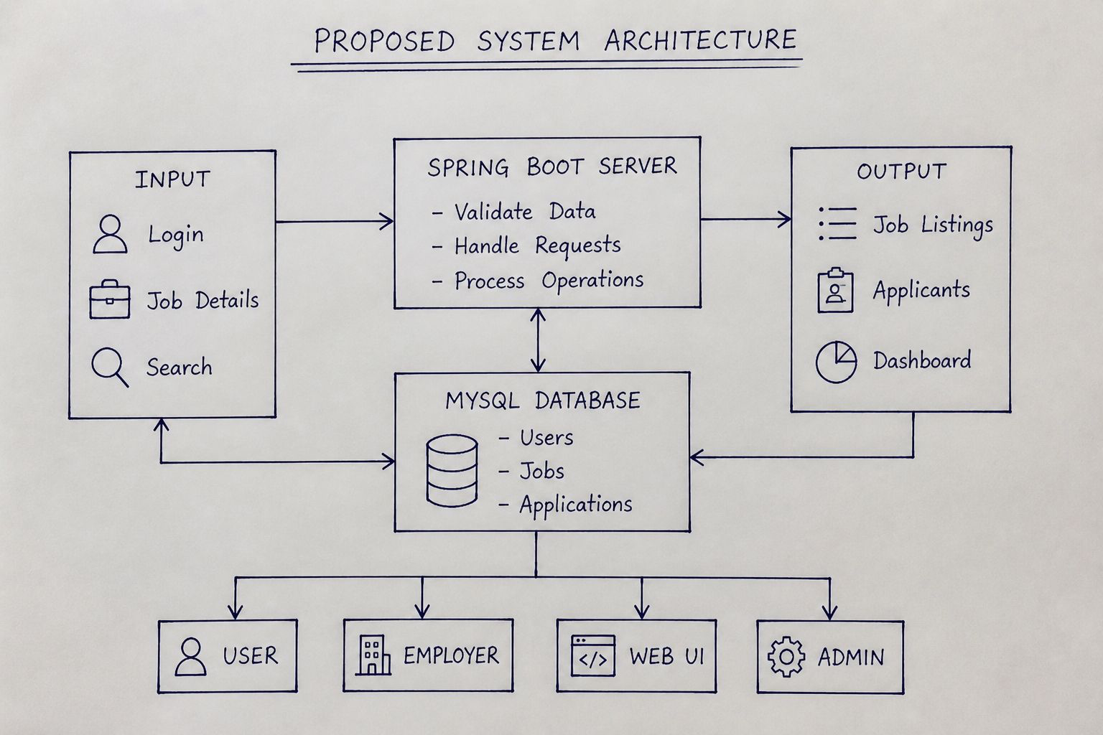
PROPOSED SYSTEM ARCHITECTURE
1
2
3
4
5
6
7
8
9

Slide 7
PROPOSED SYSTEM ARCHITECTURE
1
Input: Users interact with the frontend by submitting Login credentials for authentication, entering Job Details to create new postings, and executing Search queries to find relevant opportunities.
Processing (Spring Boot Server): The core server acts as the brain of the application. It receives the inputs to securely Validate Data, efficiently Handle Requests from users, and Process Operations such as matching applications to job postings.
Database (MySQL Database): A robust relational database acts as the persistent storage layer. It securely categorizes and holds all critical system records, specifically maintaining tables for Users, Jobs, and Applications.
Output: After processing, the system dynamically generates data back to the user interface, displaying available Job Listings, organized lists of Applicants for employers, and a comprehensive Dashboard overview.
2
3
4
5
6
7
8
9

Slide 8
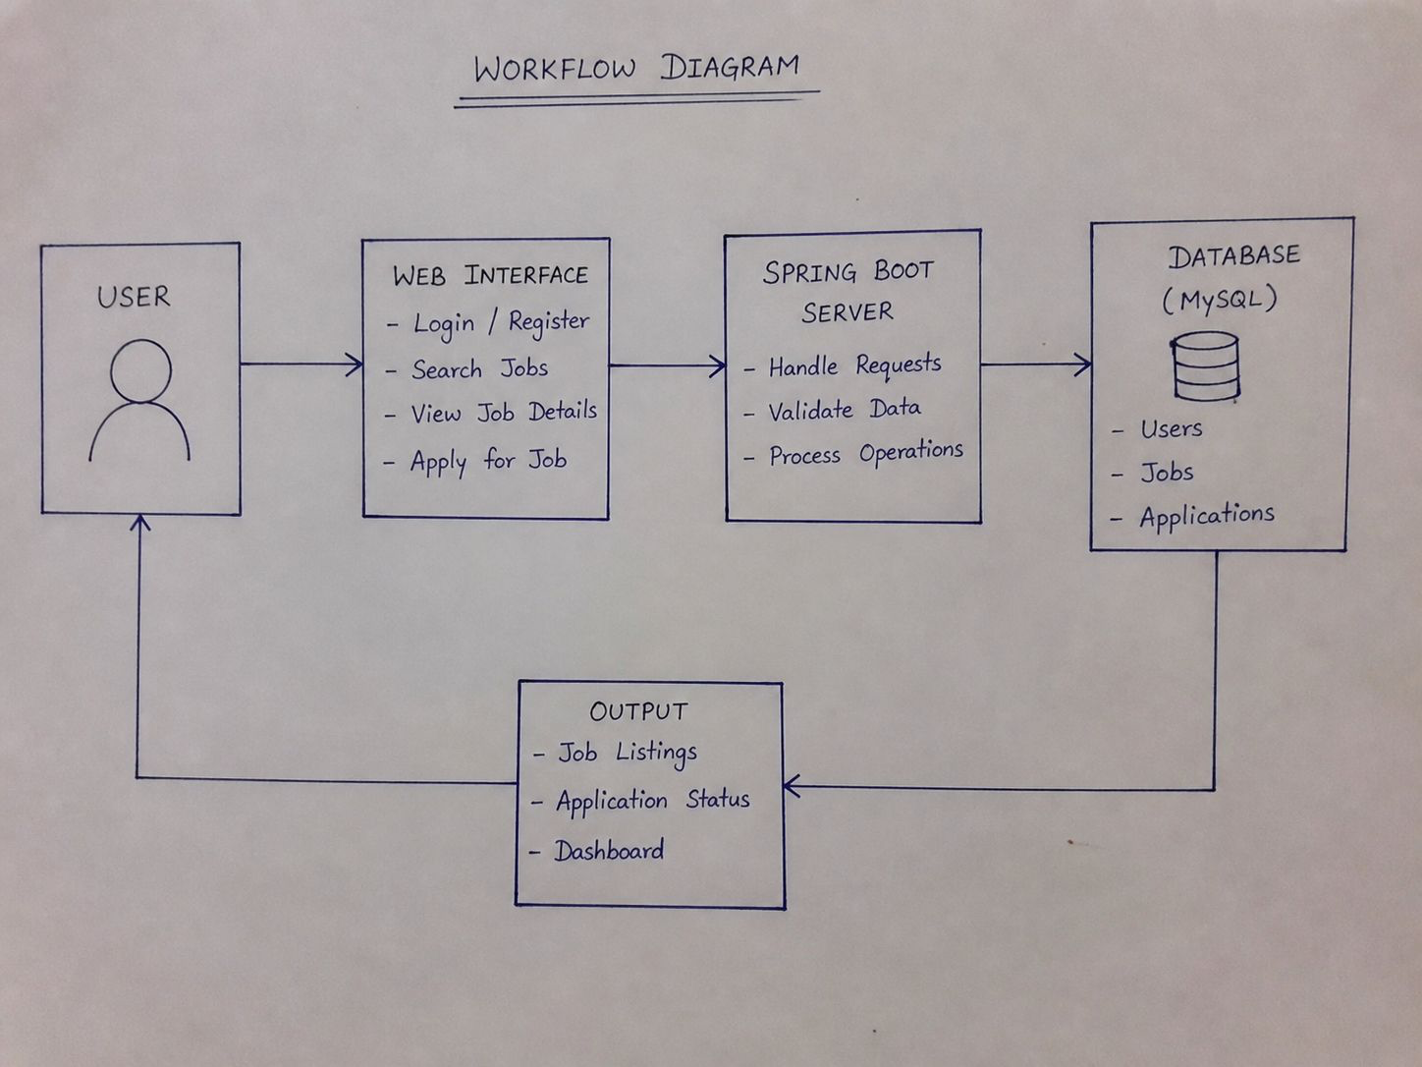
WORKFLOW
1
2
3
4
5
6
7
8
9

Slide 9
TECHNOLOGIES USED
Frontend:
- HTML, CSS, JavaScript, Thymeleaf
Backend:
- Java, Spring Boot, Spring MVC, Spring Data JPA
Database:
- MySQL
Third-Party APIs:
- Google Gemini API (for the intelligent AI Chatbot)
- OpenStreetMap / Leaflet API (for spatial map rendering and geocoding)
- Gmail SMTP Service (for automated email notifications)
Tools:
- Visual Studio Code, MySQL Workbench, Spring Initializer, Maven
Hardware/Software Requirements:
- System with minimum 4GB RAM
- JDK 17 or above
- Spring Boot
- MySQL Server
- Web Browser (Chrome)
1
2
3
4
5
6
7
8
9

Slide 10
MODULE DESCRIPTION
Module 1: User Management Handles role-based registration (Student/Employer), secure login authentication, and profile creation, including resume uploads.
Module 2: Core Processing (Job & Application Management) Implements the primary business logic, allowing employers to post jobs and students to seamlessly search, filter, and apply for opportunities.
Module 3: Database & File Management Manages the persistent storage of user profiles, job data, and application statuses securely using MySQL, while safely handling file system operations for uploaded resumes.
Module 4: Innovative Module (AI & Mapping Integration) Integrates Google Gemini API for an intelligent 24/7 chatbot assistant, and utilizes OpenStreetMap/Leaflet APIs for dynamic job location visualization and reverse geocoding.
Module 5: Notification & Tracking Powers the automated email workflow using Gmail SMTP to send instant application confirmations and deliver real-time status updates to candidates.
1
2
3
4
5
6
7
8
9

Slide 11
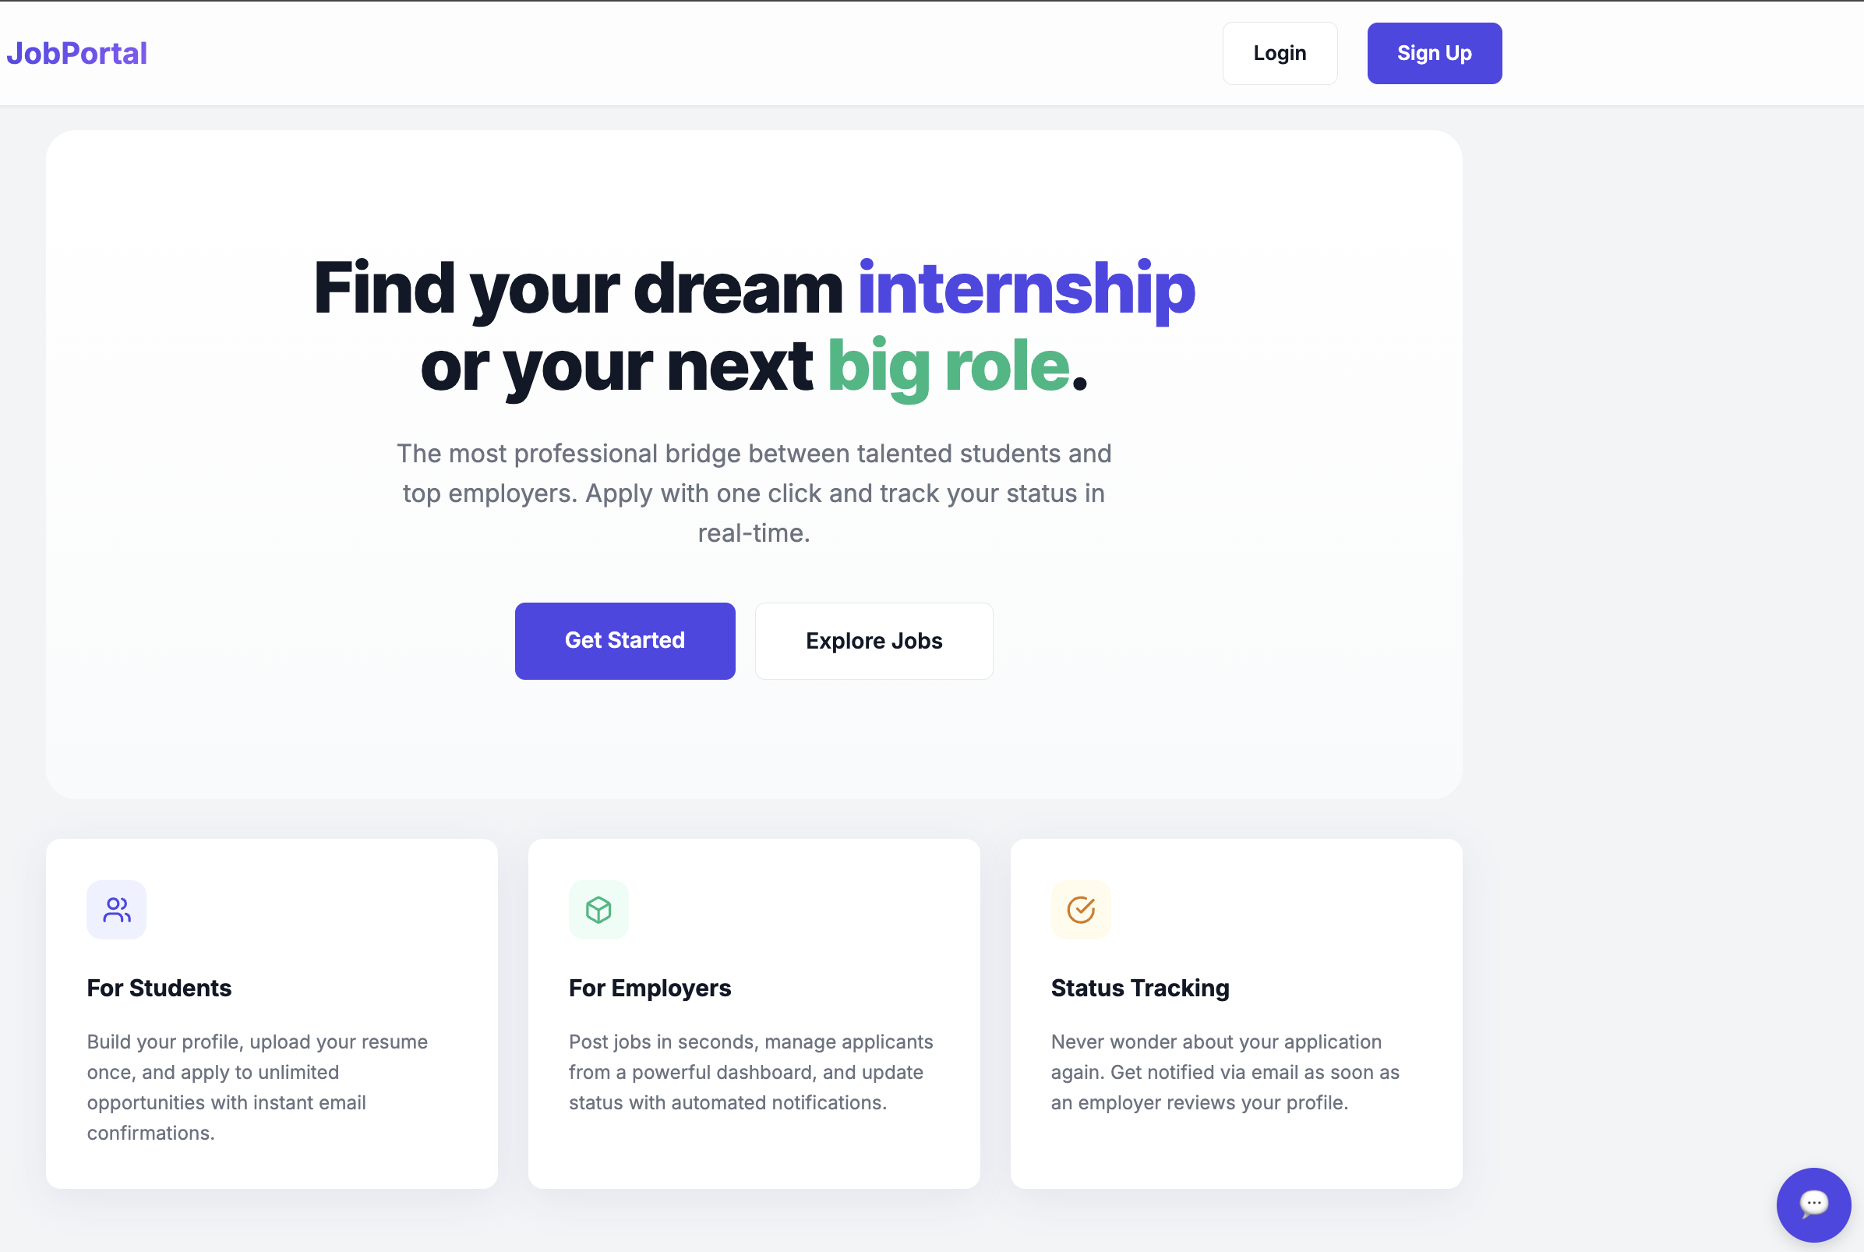
IMPLEMENTATION SCREENSHOTS
Home Page
This is the main entry page of the Job Portal where users can navigate to login or sign up.
It provides an overview of the platform and allows users to explore job opportunities or get started.
1
2
3
4
5
6
7
9
9

Slide 12
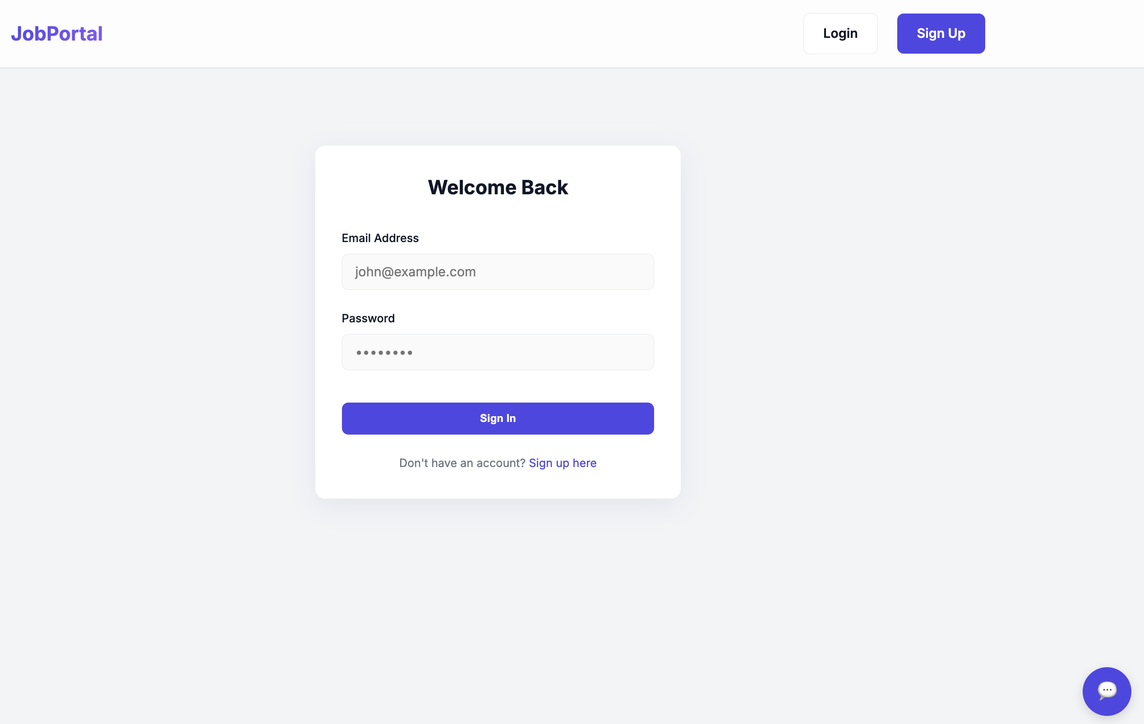
IMPLEMENTATION SCREENSHOTS
Login Page
1
2
3
4
5
6
7
9(A)
• This page allows registered users or employers to log in using their email and password.
• It provides secure access to the system and redirects users to their respective dashboards after successful
login.
9

Slide 13
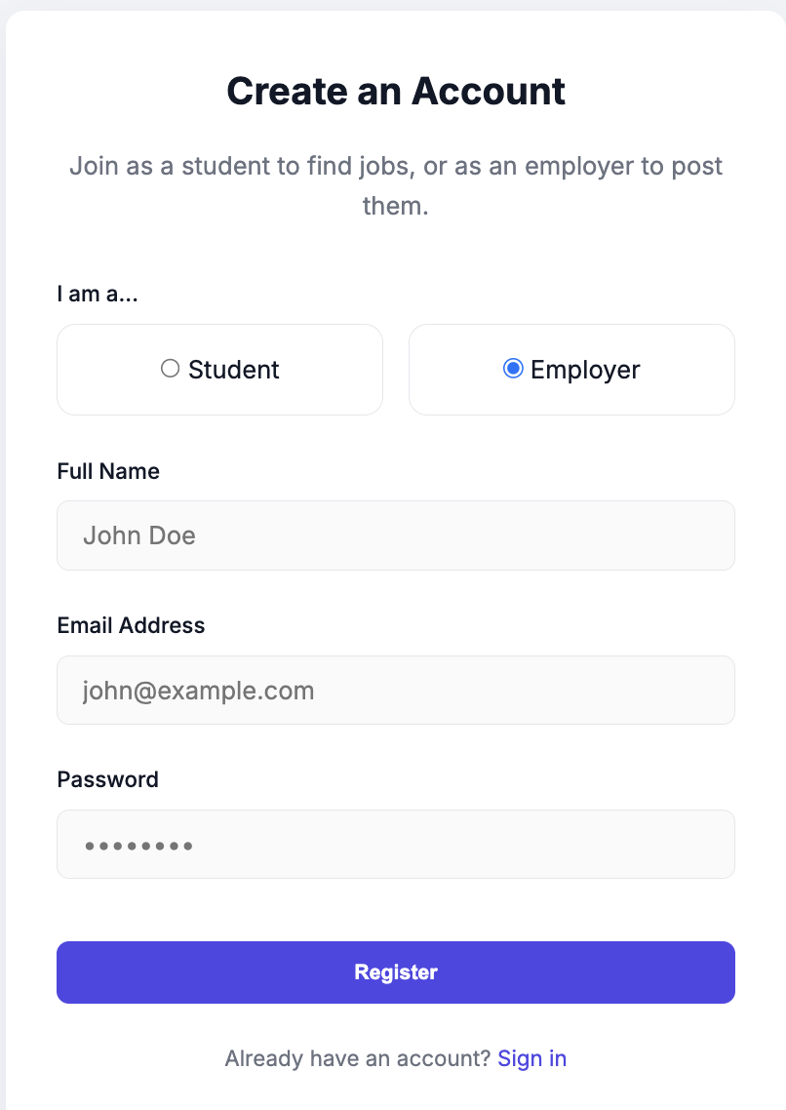
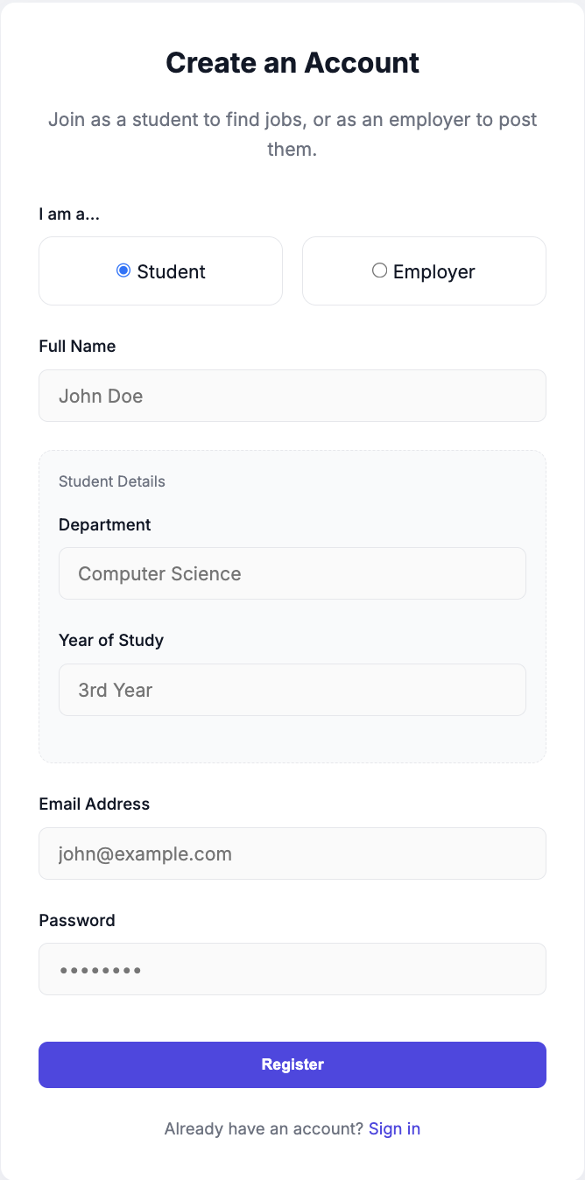
IMPLEMENTATION SCREENSHOTS
Employer Register Page
Student Register Page
1
2
3
4
5
6
7
9(B)
9
Allows recruiters to quickly and securely set up their company accounts.
Grants them immediate access to post new jobs and review applicants.
Dynamically asks for specific academic details like department and year of study.
Helps job seekers build a complete profile to easily search and apply for roles.

Slide 14
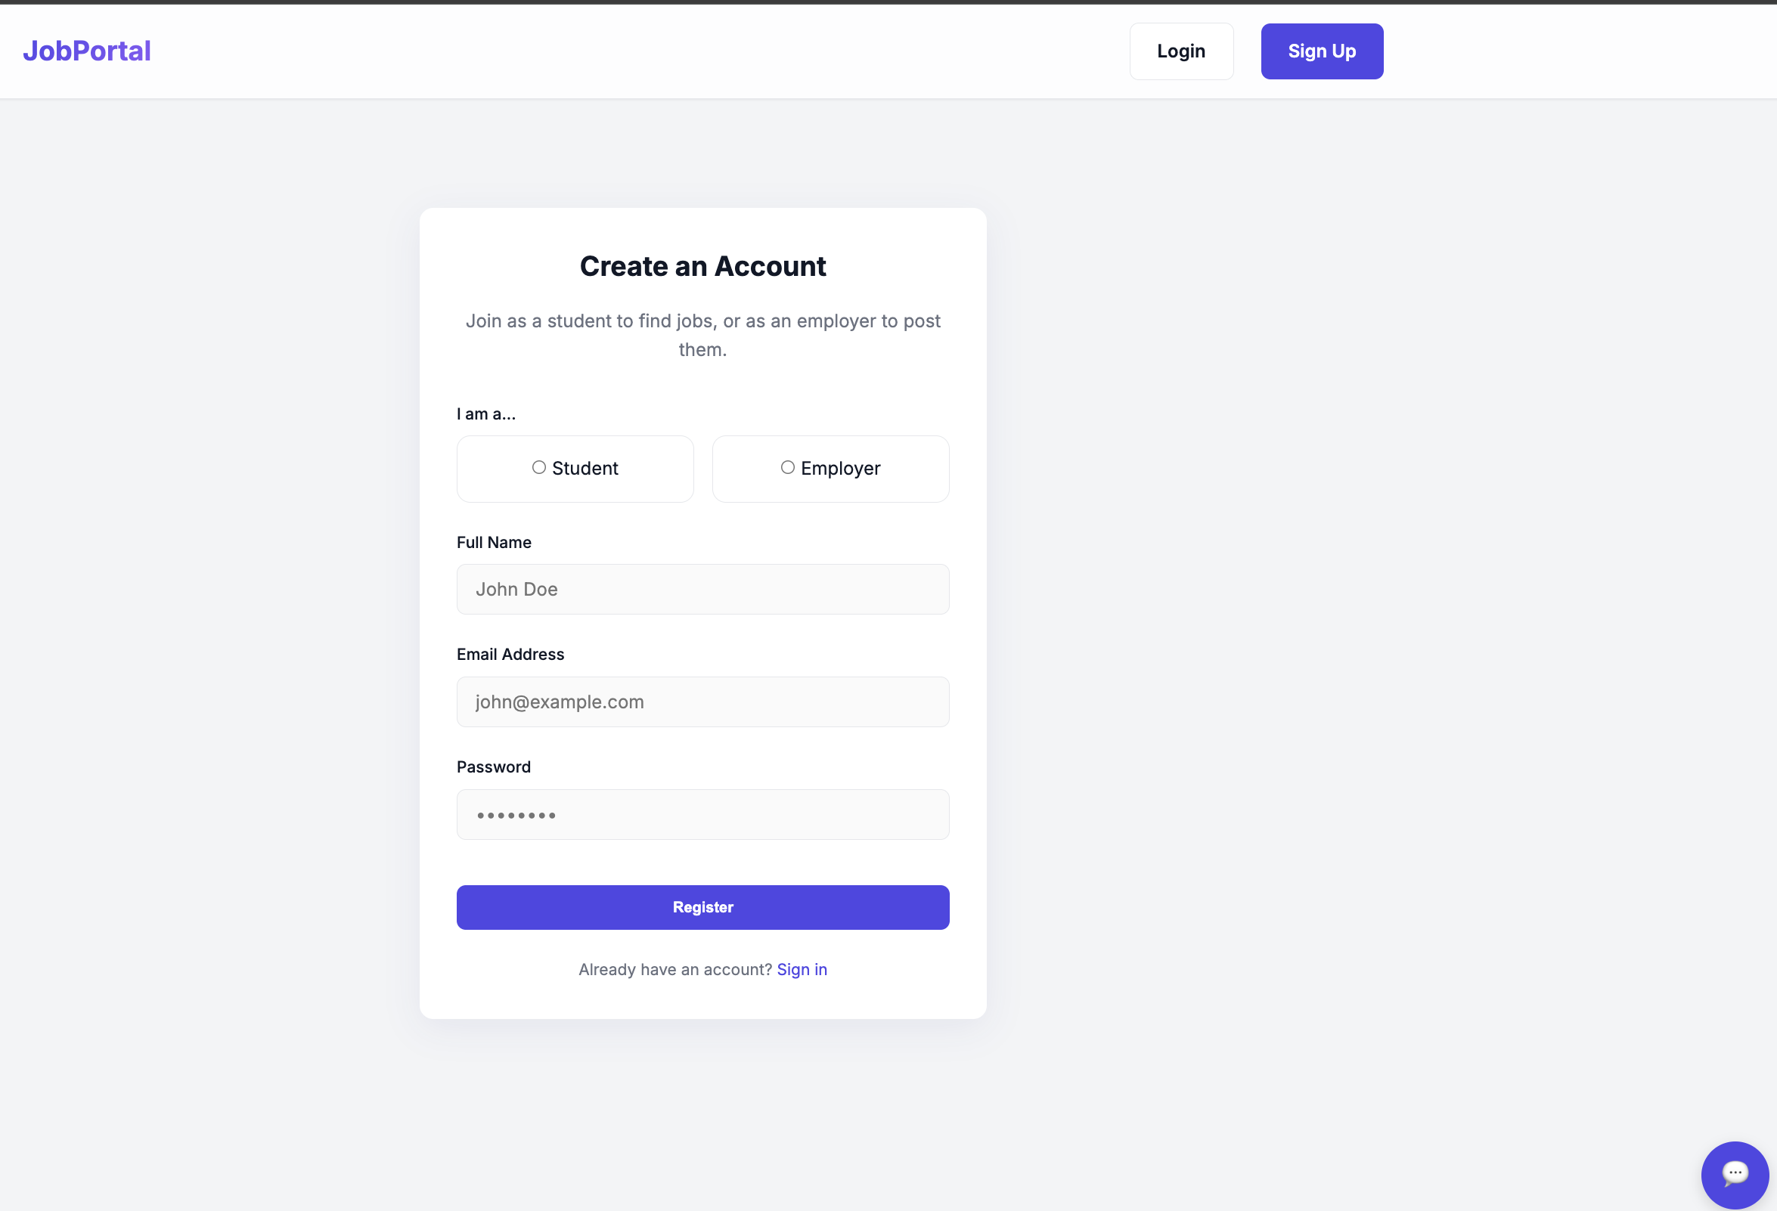
IMPLEMENTATION SCREENSHOTS
Module 1
1
2
3
4
5
6
7
9(C)
Provides a secure, role-based registration and login system specifically tailored for both job seekers and recruiters.
Dynamically adapts the profile creation form to capture a student's academic details while keeping the employer registration fast and streamlined.
9

Slide 15
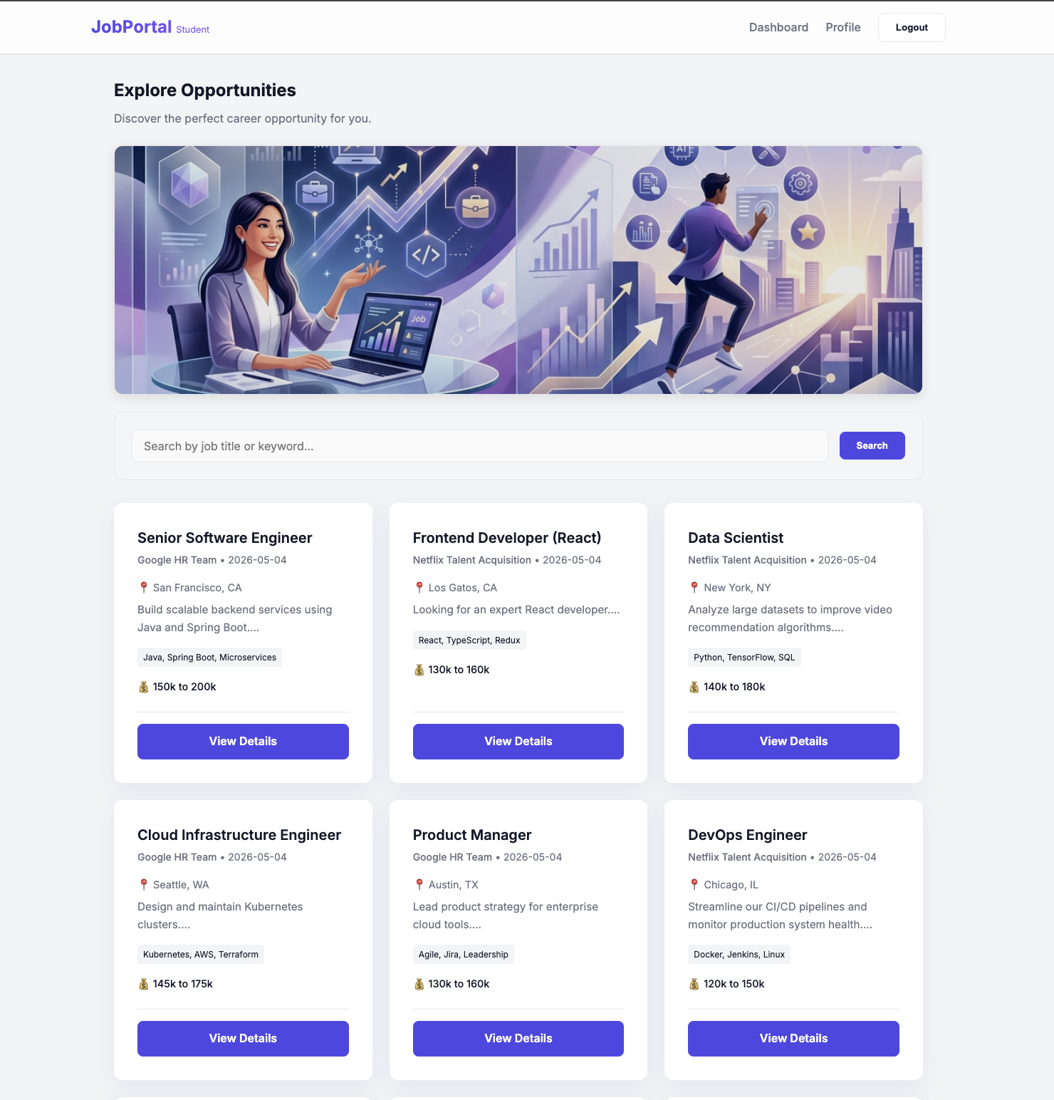
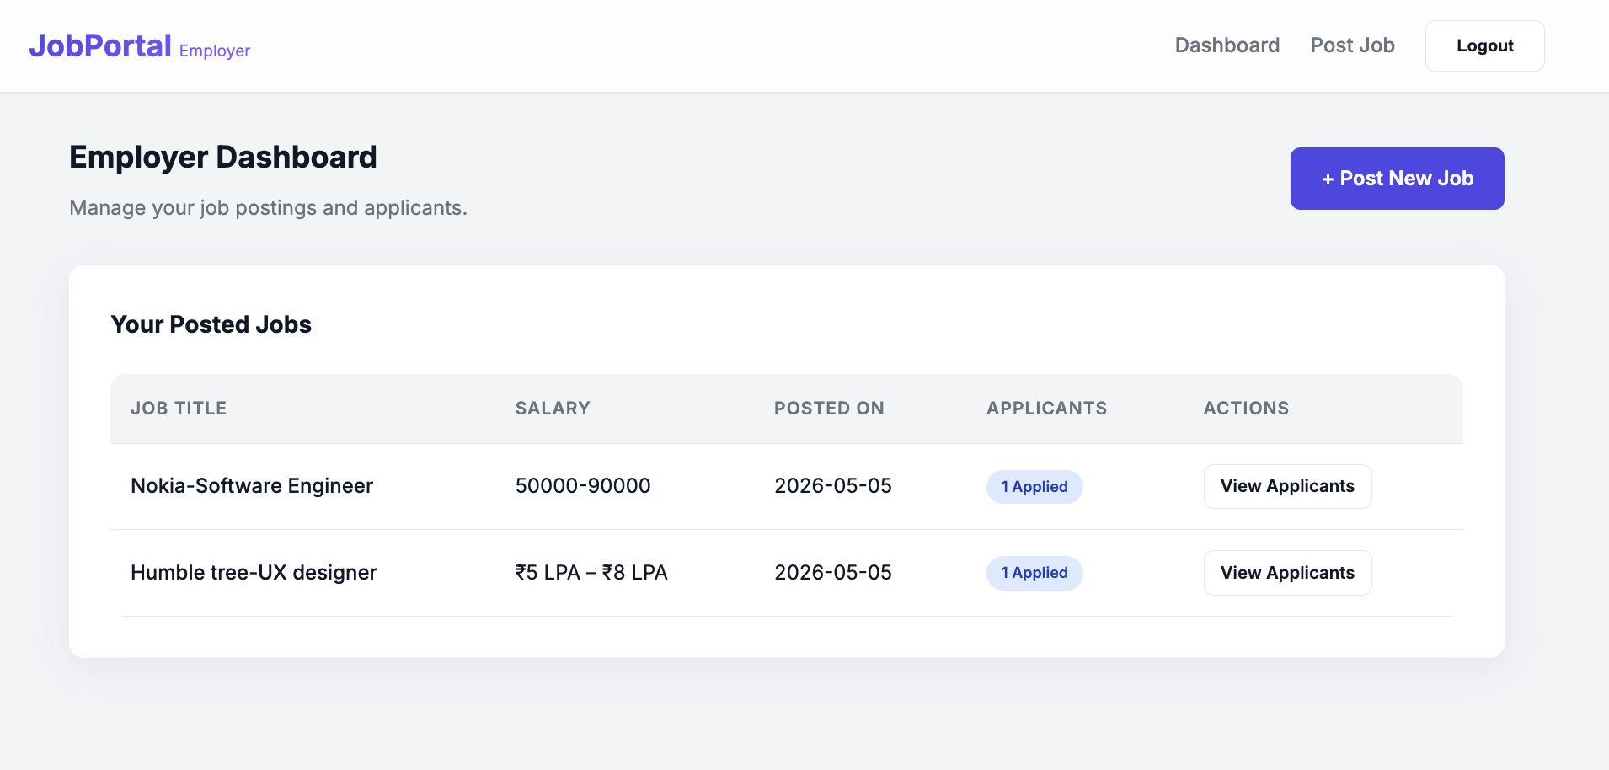
IMPLEMENTATION SCREENSHOTS
Module 2
1
2
3
4
5
6
7
9(D)
This module drives the primary business logic, enabling employers to seamlessly post new opportunities and manage incoming applicant data.
It provides job seekers with an intuitive dashboard to instantly browse, filter, and apply for relevant roles with a single click.
9

Slide 16
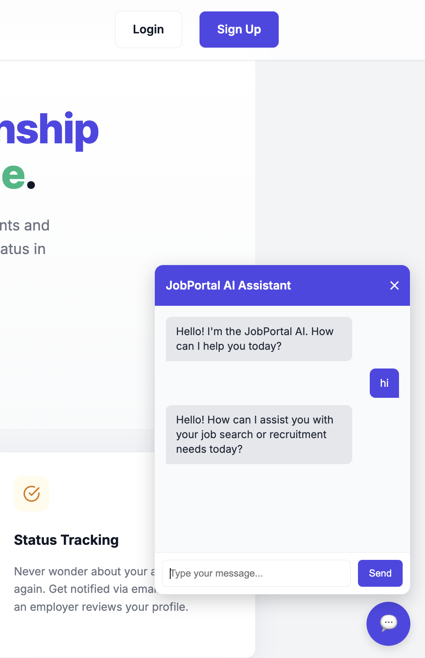
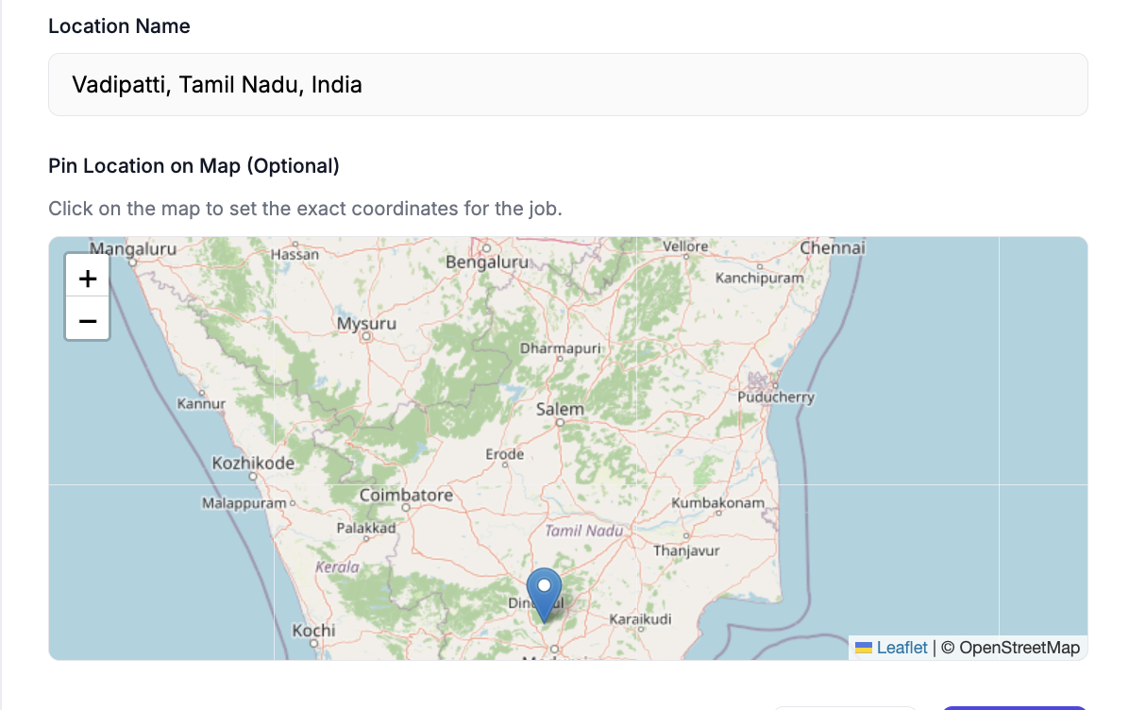
IMPLEMENTATION SCREENSHOTS
Innovative Module
1
2
3
4
5
6
7
9(E)
This module integrates cutting-edge technologies by featuring a Google Gemini-powered AI Chatbot for instant, 24/7 user guidance.
It also utilizes OpenStreetMap APIs to provide dynamic, interactive geospatial mapping for precise job location targeting and reverse geocoding.
9

Slide 17
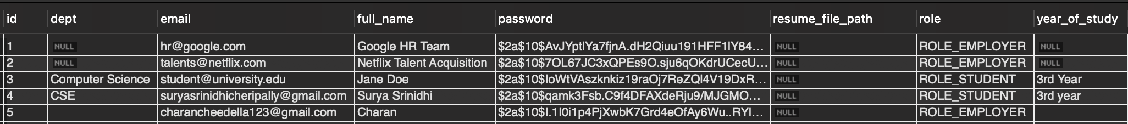
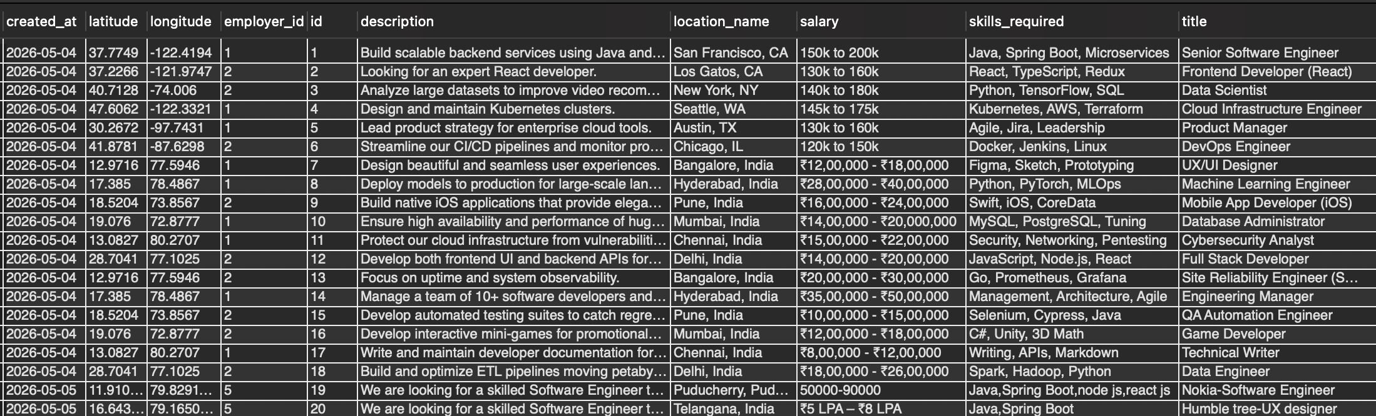
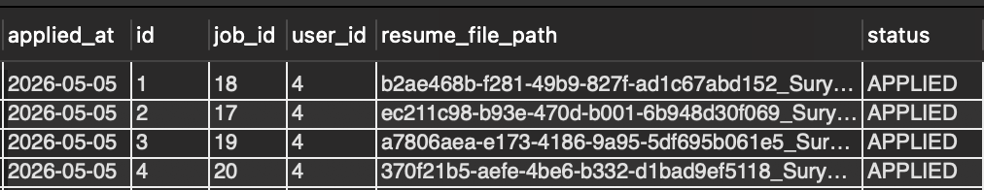
IMPLEMENTATION SCREENSHOTS
Database Screenshots
1
2
3
4
5
6
7
9(F)
9

Slide 18
ADVANTAGES & LIMITATIONS
Advantages
Intelligent Assistance: The integrated Google Gemini AI Chatbot provides instant, 24/7 support and guidance for all users.
Automated Notifications: The system sends real-time email updates, ensuring candidates are instantly informed about their application statuses.
Interactive Mapping: Built-in geospatial mapping allows students to visually locate job opportunities and helps employers specify exact work locations.
Streamlined Workflow: Creates a centralized, easy-to-use platform that effortlessly bridges the gap between recruiters and job seekers.
Limitations
No Payment Gateway: The current system does not support monetization features like premium job postings or paid employer subscriptions.
Third-Party Dependency: The AI Chatbot relies heavily on an external API (Google Gemini), meaning it requires an active internet connection and API key to function.
Basic Analytics: While highly functional, the platform currently lacks advanced, data-driven graphical analytics and complex reporting dashboards for employers.
1
2
3
4
5
6
7
8
10

Slide 19
Thank you

